Slide 1
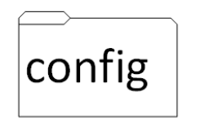

Value Stream Mapping – Terraform Modules – Current State
Terraform (.tf)
backend.tf
main.tf
outputs.tf
provider.tf
terraform.tfvars
variables.tf
Workflow (.yaml)
Steps:
Check out code
Terraform format
Lint Terraform
Execute commands
Steps:
git clone
gcloud auth login
terraform init
terraform plan
terraform apply
Ticket Creation
Add Credentials in GCP
Create cloud storage bucket
Clone repository
Google Cloud Authentication
variables.tf
main.tf
outputs.tf
*.tfvars → variables.tf → main.tf → outputs.tf
Estimate Time:
1-2 min
1-2 min
2-3 min
1 min
10 sec
10 sec
10 min

